Slide 1
TARP (ECE3999)
SELF DRIVING CARS
USING CONVOLUTIONAL NEURAL NETWORKS
17BEC0114 – S ARUN KARTHIK
17BEC0458 – S P SHARVARI
17BEC0633 – ADITYA SHARMA
17BIS0101 – A T RUTHVIK SRINIVAS

Slide 2

SELF DRIVING CAR A self-driving car, also known as an autonomous car, driverless car, or a robotic car, is a vehicle that is capable of sensing its environment and moving safely with little or no human input.

Slide 3

ABSTRACT
Driverless cars stand to solve all sorts of problems, like traffic delays and traffic collisions caused by driver error.
Autonomous vehicles will bring to market all sorts of new and exciting applications for a variety of industries, like shipping, transportation, and emergency transportation.
The ultimate goal of self-driving cars is to delegate the responsibility of driving to a machine.
Here, we use a neural network to clone car driving behavior. It is a supervised regression problem between the car steering angles and the road images in front of a car.

Slide 4
OBJECTIVE
To train an end-to-end deep learning model that would let a car drive by itself around the track in a driving simulator.
We’ll use Udacity’s driving simulator which has two different tracks. One of them will be used for collecting training data, and the other one — never seen by the model — as a substitute for the test set.
For training our model, we would drive the car using arrow keys in the training track and we collect the data by recording in the simulator.
Now after we train our model, we would evaluate its performance on a completely different ‘testing track’ where the car will be made to run autonomously.

Slide 5
LITERATURE SURVEY
Bojarski, M., Del Testa, D., Dworakowski, D., Firner, B., Flepp, B., Goyal, P., Jackel, L.D., Monfort, M., Muller, U., Zhang, J. and Zhang, X., 2016. End to end learning for self-driving cars. arXiv preprint arXiv:1604.07316.
In the paper, the authors used a CNN architecture to extract features from the driving frames. The network was trained using augmented data, which was found to improve the model’s performance. Shifted and rotated images were generated from the training set with corresponding modified steering angles.
This approach was found to work well in simple real-world scenarios, such as highway lane-following and driving in flat, obstacle-free courses. Several research efforts have been undertaken to build more complex perception-action models to tackle the myriad of environments, and unpredictable situations usually encountered in urban environments.

Slide 6
LITERATURE SURVEY
J. Huang, V. Rathod, C. Sun, M. Zhu, A. Korattikara, A. Fathi, I Fischer, Z. Wojna, Y. Song, S. Guadarrama, et al. Speed/accuracy trade-offs for modern convolutional object detectors. In Computer Vision and Pattern Recognition (CVPR), 2017.
This work adopts the CIFAR-10 dataset, in which a very wide and deep network architecture is developed, combined with GPU support to decrease training time. On popular datasets, such as the MNIST handwritten digits, Chinese characters, and the CIFAR-10 images, near-human performance is achieved.
The extremely low error rates beat prior state-of-the-art results significantly. However, it has to be mentioned that the network used for the CIFAR-10 dataset consists of 4 convolutional layers with 300 maps each, 3 max-pooling layers, and 3 fully connected 6 Page output layers. As a result, although a GPU was used, the training time was several days.

Slide 7
METHODOLOGY
As we drive the car through the simulator, we are going to be taking images at each instance of the drive. These images are going to represent our training data set and the label for each specific image is going to be the steering angle of the car at that specific instance.
We will then show all of these images to our Convolutional Neural Network (CNN) and allow it to learn how to drive autonomously by learning from our behavior as a manual driver.
The driving simulator would save frames from three front-facing “cameras”, recording data from the car’s point of view; as well as various driving statistics like the throttle, speed, and steering angle. We are going to use camera data as model input and expect it to predict the steering angle in the [-1, 1] range.

Slide 8
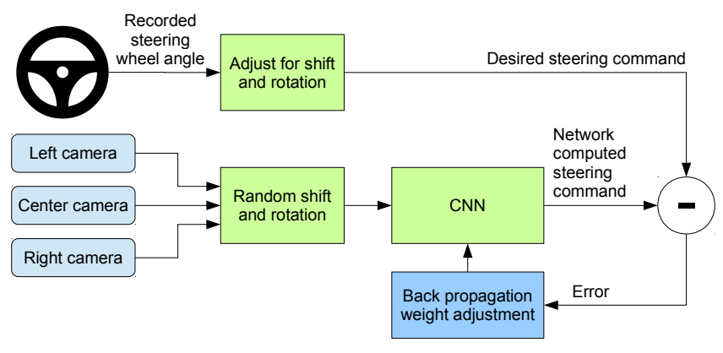
Now after we train our model, we are going to evaluate its performance on a completely different ‘testing track’ where the car will be made to run autonomously. If we can train the car properly, it will perform very well on our second track and will drive on its own.
The Behavioral Cloning Technique is incredibly useful and plays a big role in real-life Self Driving Cars as well.

Slide 9
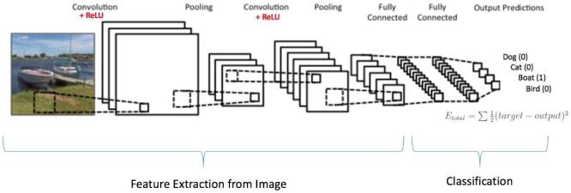
SOFTWARE USED
We have used an open source software provided by Udacity for our project and python programming language here to develop our model.
In this software there are two types of modes. One is Training mode and other is Autonomous mode.
Convolutional Neural Network Design

Slide 10
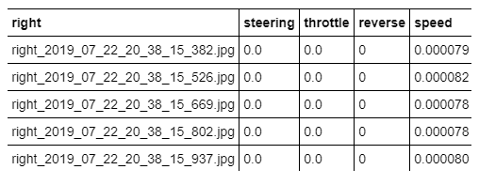
PLAN/MODULES
Gathering Data
First we have to drive the car in the Training track and we should collect the data by recording in the simulator. Normal Arrow Keys are used to drive the car. Once the recording is done we can see our data in the folder that we selected before recording.
An Excel sheet of Data and Image folder is produced. The excel sheet contains lots of data. A sample of it is shown below.

Slide 11
PLAN/MODULES
2. Image Pre-processing
The images are cropped so that the model won’t be trained with the sky and the car front parts. The images are then resized as per the NVIDIA model.
The picture is taken by the Car which has three front cameras. They are center, left, right image. Below are the images of all the three cameras at one particular instance.
Center Image
Left Image Right Image

Slide 12
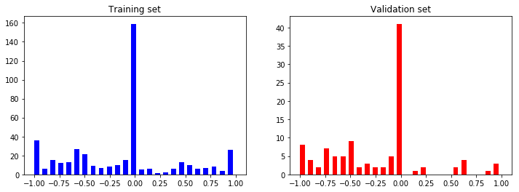
PLAN/MODULES
3. Training and Validation split
We will then split the images into training and validation set in order to measure the performance at every epoch.
We split the data using the 80–20 rule which means using 80% of the data for training while the rest for testing the model on unseen images.
Steering Angle Distributions

Slide 13
PLAN/MODULES
4. Model Training (Image Augmentation)
For training, we use the following augmentation technique along with Python generator to generate unlimited number of images:
Randomly choose right, left or center images.
For left image, steering angle is adjusted by +0.2
For right image, steering angle is adjusted by -0.2
Randomly flip image left/right
Randomly translate image horizontally with steering angle adjustment (0.002 per pixel shift)
Randomly translate image vertically
Randomly added shadows
Randomly altering image brightness (lighter or darker)
Using the left/right images is useful to train the recovery driving scenario. The horizontal translation is useful for difficult curve handling (i.e. the one after the bridge).

Slide 14
PLAN/MODULES
Below we show all the Augmenting Images
Below is the preprocessed image which is actually used in training to train the car whether if it’s raining or any climatic changes are there.

Slide 15
EXPECTED OUTCOMES
Now after we train our model, we are going to evaluate its performance on a completely different ‘testing track’ where the car will be made to run autonomously.
If we are able to train the car properly, it will perform very well on our second track and will drive on its own.
The Behavioral Cloning Technique is incredibly useful and plays a big role in real-life Self Driving Cars as well.
If we have trained our model perfectly, by testing it in new track (autonomous mode) shown below our car will move without hitting the edge of the road. Then we come to know that we have trained our model perfectly.

Slide 16
IMPACT TO SOCIETY
1. Road Safety
With human errors being the cause for around 90% of traffic accidents, delegating the vehicle operation responsibilities to a machine can reduce the accidents and thus increase road safety.
2. Reduced emissions
Autonomous capabilities such as consistent driving speeds and keeping a measured distance between vehicles can reduce unnecessary braking and re-acceleration. They further reduce pollution by eliminating or lessening the use of fuel.
3. Eases Traffic Congestion
Because self-driving cars are rarely involved in accidents, their potential to ease congestion is high. Not only that, because self-driving cars can communicate with each other, they would also eliminate the need for traffic signals. By driving at a slower rate but with fewer stops, better-coordinated traffic would lead to less congestion.

Slide 17
THANK YOU

